Slide 1
Migrating Applications to Microsoft Azure
<Presenter Name>

Slide 2

Agenda
Contoso Application Challenges
Cloud Computing Execution Models
Migrating On-Premises Application to:
Virtual Machines
Cloud Services
App Services
Azure Service Fabric
Migrating Application Database:
Azure SQL Database
SQL Server in IaaS
Migrate the Authentication mechanism to Azure Active Directory
Partner Audience: Developer, Architects, IT Pros

Slide 3
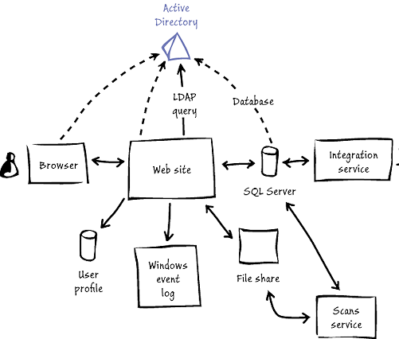
Scenario – Migrating an App to Azure
Contoso Challenges
Contoso faces several challenges. Currently, deploying new on-premises applications takes too long, considering how quickly its business changes and how efficient its competitors are. The timeframe for acquiring, provisioning, and deploying even a simple application can be at least several weeks. No matter the application's complexity, requirements must be analyzed, procurement processes must be initiated, requests for proposals may need to be sent to vendors, networks must be configured, and so on. Contoso must be able to respond to its customers' demands more rapidly than the current procedures allow.

Slide 4
Application Migration

Slide 5
Topics to consider – Top 10 questions
IaaS or PaaS? Virtual Machines, Cloud Services, Web Sites?
Authentication?
Storage?
What are the Session State requirements?
What are the Load Balancing and High availability requirements?
Database: SQL Server on VM versus Azure SQL?
Network: Hybrid Connectivity, Latency
Who will be involved? Dev, IT Pro
What is the main purpose of migrating to the Cloud? Which problem needs to be solved?
First time working with Cloud / Azure?

Slide 6
Why consider the cloud?
Public Cloud Platform
$30
Speed
Scale
Economics
$25
$20
Market Share (in Billions)
$15
$10
$5
2008
2009
2010
2011
2012
2013
2014
2015
2016
2017
2018
2019
2020

Slide 7
Microsoft Azure delivers.
Enterprise ready by design.
Integration
Heterogeneity
Security
On-premises
AND cloud
Open, Broad, Flexible
Trustworthy
On-premises and Cloud
Broad and flexible
Secure and reliable

Slide 8
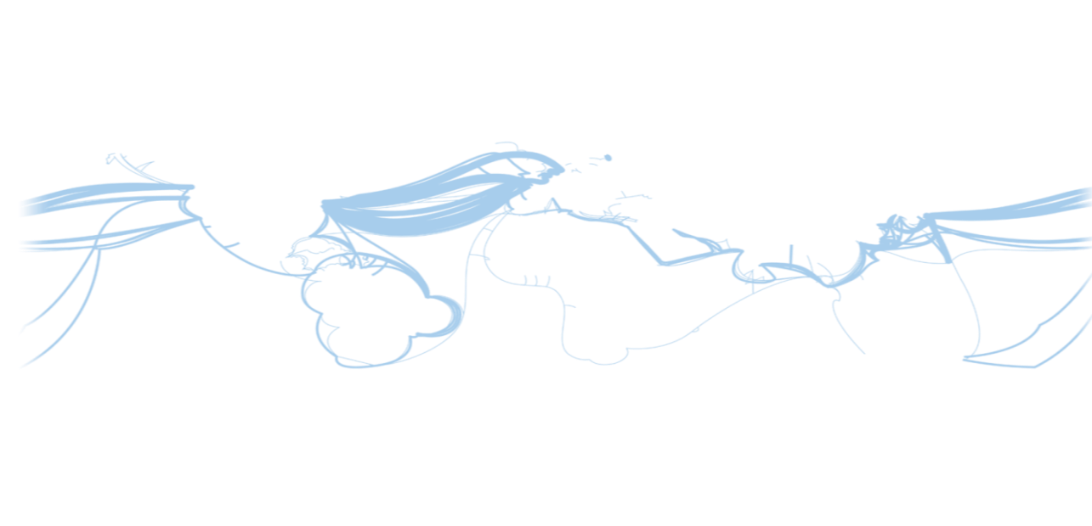
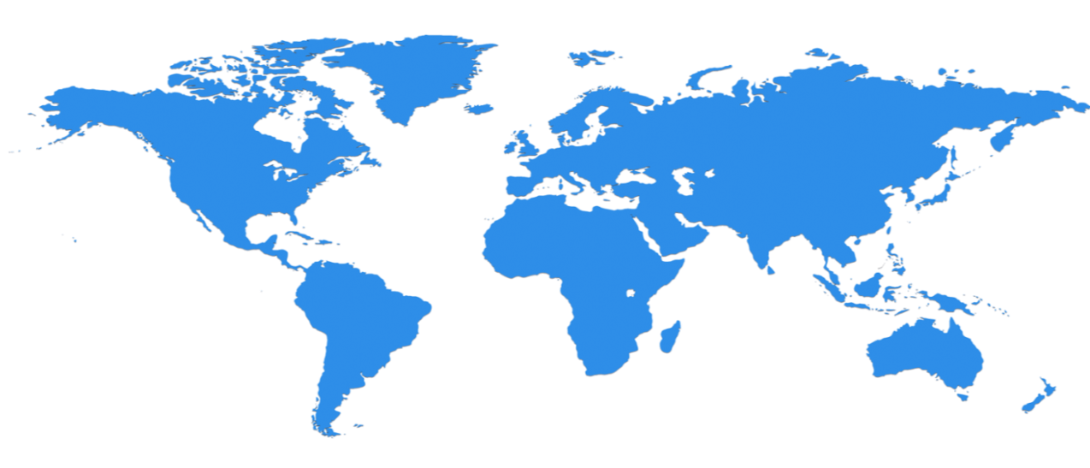

Huge infrastructure scale is the enabler
19 Regions ONLINE…huge datacenter capacity around the world…and we’re growing
Canada
Toronto
Canada
Quebec
North Europe
Ireland
West Europe
Netherlands
Central US
Iowa
North Central US
Illinois
US Gov
Iowa
China North *
Beijing
East US
Virginia
Japan East
Saitama
West US
California
China South *
Shanghai
East US 2
Virginia
Japan West
Osaka
India West
Mumbai
India East
Pune
South Central US
Texas
US Gov
Virginia
India Central
Chennai
East Asia
Hong Kong
SE Asia
Singapore
Australia East
Sydney
Brazil South
Sao Paulo
100+ datacenters
One of the top 3 networks in the world (coverage, speed, connections)
2 x AWS and 6x Google number of offered regions
G Series – Largest VM available in the market – 32 cores, 448GB Ram, SSD…
Australia West
Melbourne
Operational
Announced
* Operated by 21Vianet

Slide 9
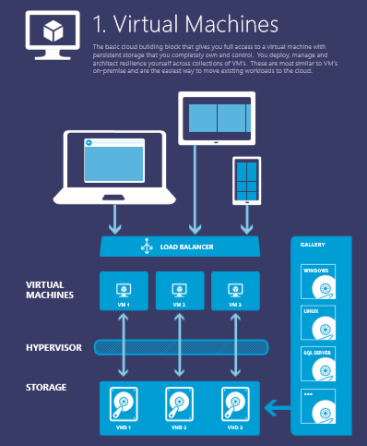
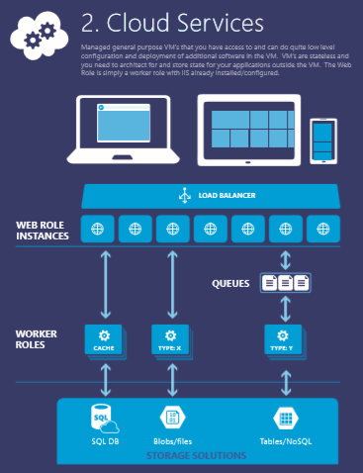
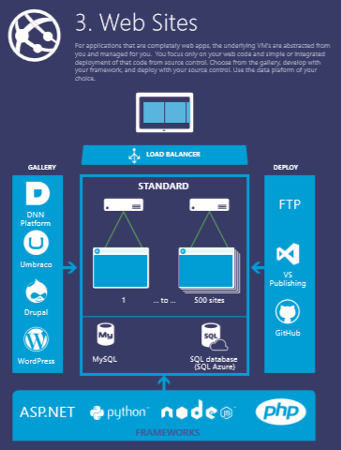
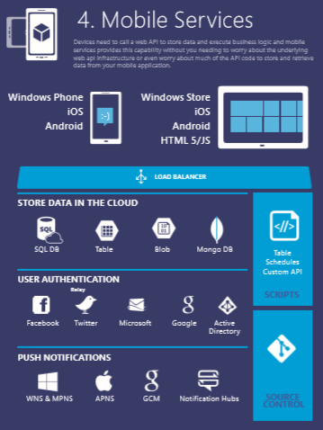
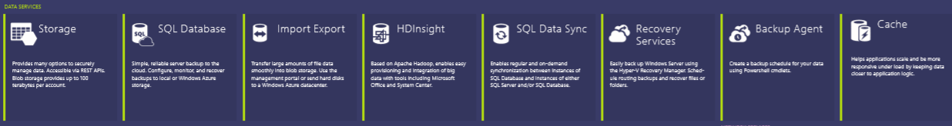





Slide 10
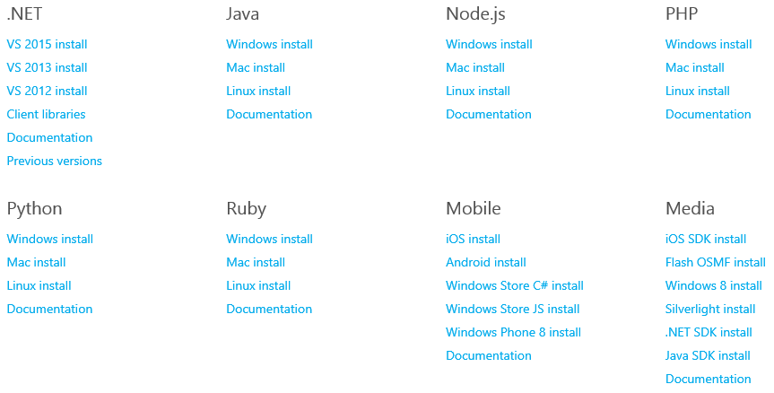
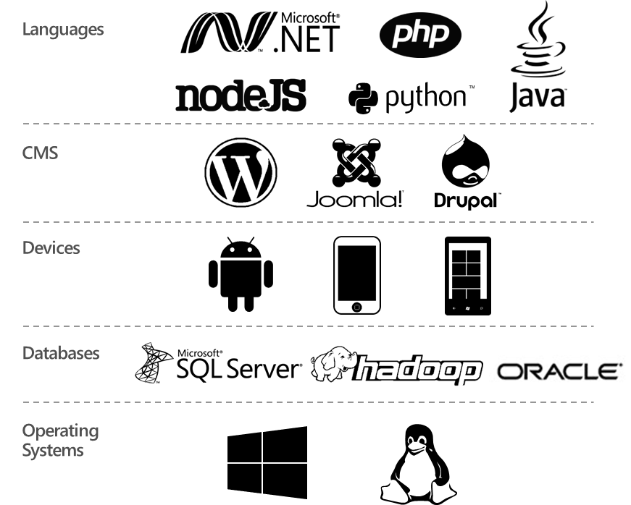
What Applications Can I Migrate ?
Download and install language-specific SDKs and tools for your platform of choice.
What about off-the-shelf products?

Slide 11
Cloud Execution Models
Traditional
IaaS
PaaS
SaaS
You Manage
Applications
Applications
Applications
Applications
Data
You Manage
Data
Data
Data
Runtime
Runtime
Runtime
Runtime
Managed by Microsoft
You Manage
Middleware
Middleware
Middleware
Managed by Microsoft
Middleware
Operating System
Operating System
Operating System
Operating System
Managed by Microsoft
Virtualization
Virtualization
Virtualization
Virtualization
Servers
Servers
Servers
Servers
Storage
Storage
Storage
Storage
Networking
Networking
Networking
Networking
Windows Server
Azure Virtual Machines
Windows Server Hyper-V
Azure Cloud Services & App Services
Office 365
Dynamics CRM

Slide 12
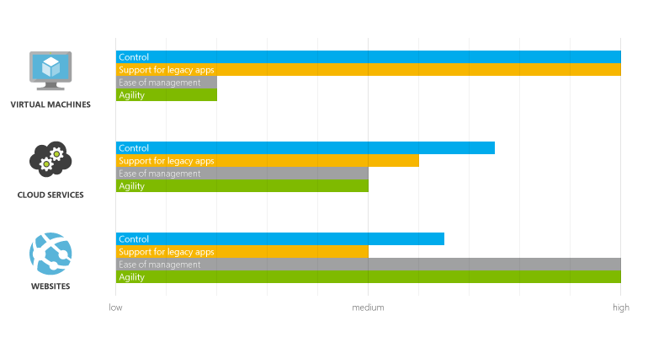
Execution Models
One of the most basic things a cloud platform does is execute applications. Microsoft Azure provides three options for doing this:
App services

Slide 13
Open Choice at Every Layer
Web Apps
Mobile
Apps
Media
Vertical compute PaaS
App Service
Batch
General Compute PaaS
Apprenda, CloudFoundry
Jelastic, Marathon
Service Fabric
(VMs and Containers)
Cluster Orchestration
SCALR, RightScale,
Mesos, Swarm
VM Extensions
IaaS and IaaS+
VMs and VM Scale Sets
Infrastructure
Azure-Consistent Private Cloud
Azure Public Cloud

Slide 14
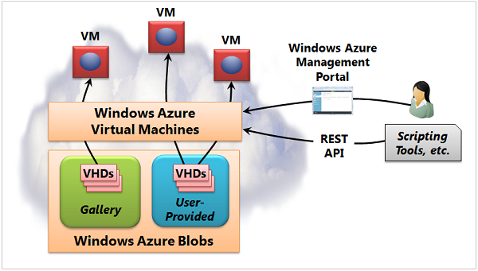
Virtual Machines
When to use Virtual Machines
Provides the most general solution.
Most control possible (manage OS, application).
Virtual Machines is also the best choice for running off-the-shelf on-premises applications

Slide 15
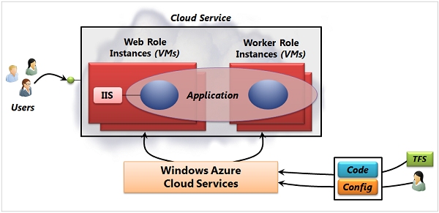
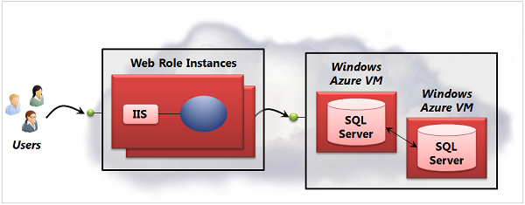
Cloud Services
When to use Cloud Services
Administrative access to your application's VMs.
Multi-tier applications that need separate VMs for their business logic. (Web and Worker Roles)
Separate staging and production environments.
Use networking technologies such as Azure Virtual Network, ExpressRoute and VPN.

Slide 16
Azure Service Fabric
LifecycleMgmt
Independent Scaling
Independent Updates
Always On Availability
Resource Efficient
Stateless/
Stateful
Public Cloud
On Premises
Private cloud
Other Clouds

Slide 17


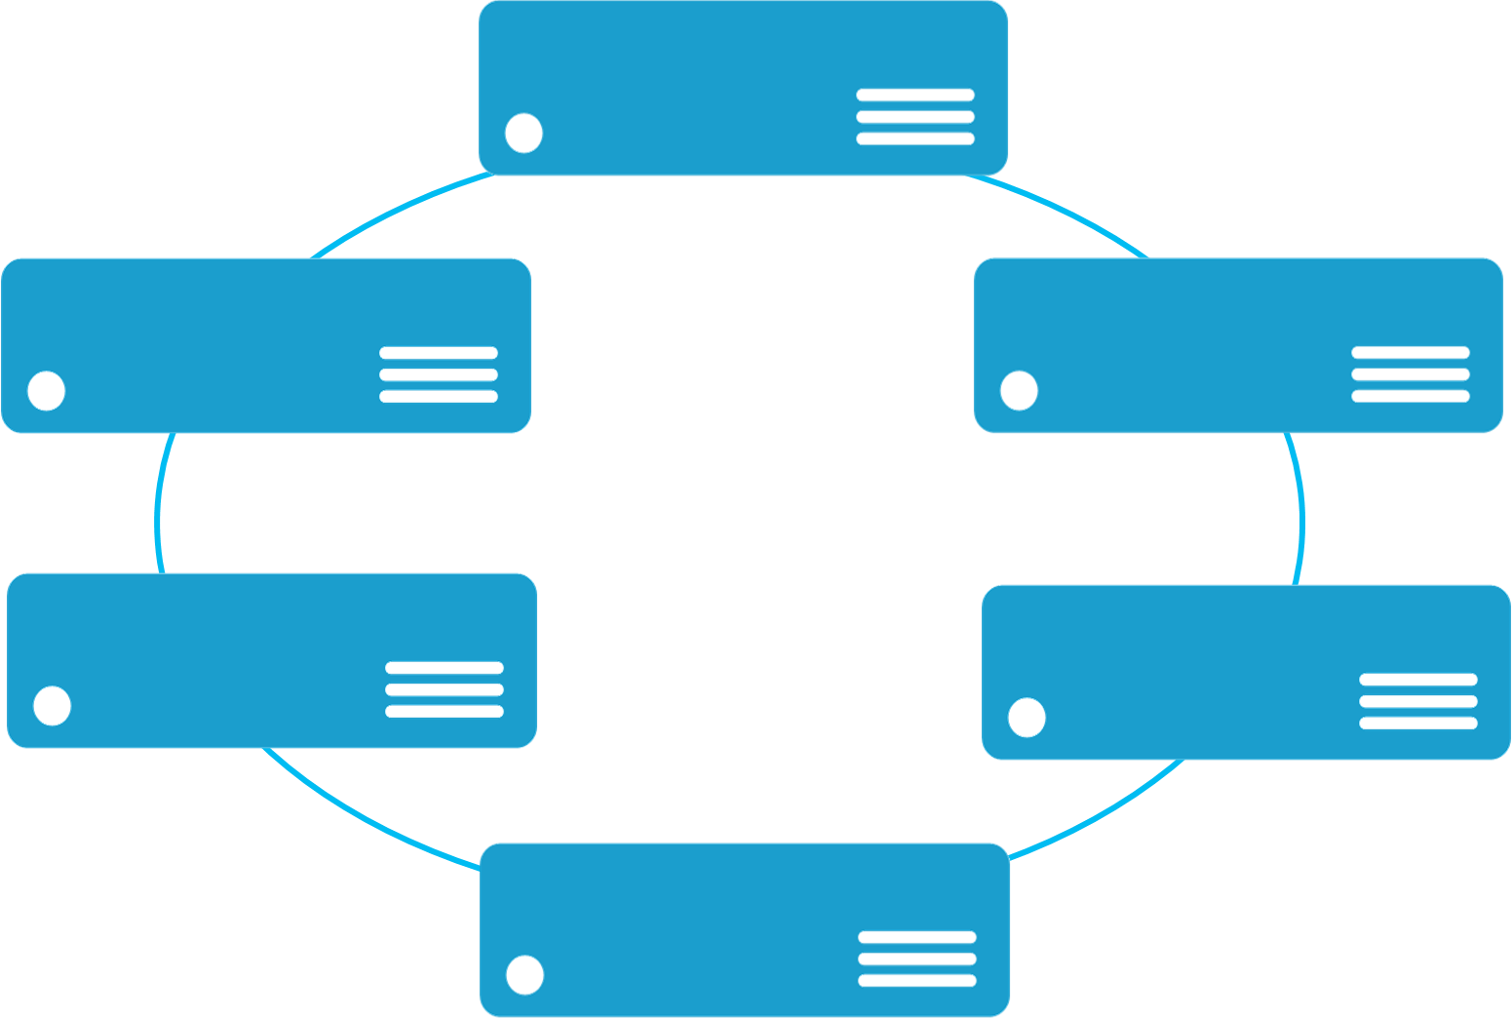


Monolithic application approach
Microservices application approach
A monolith app contains domain specific functionality and is normally divided by functional layers such as web, business and data
App 1
App 1
App 2
A microservice application separates functionality into separate smaller services.
Scales by cloning the app on multiple servers/VMs/Containers
Scales out by deploying each service independently creating instances of these services across servers/VMs/containers

Slide 18
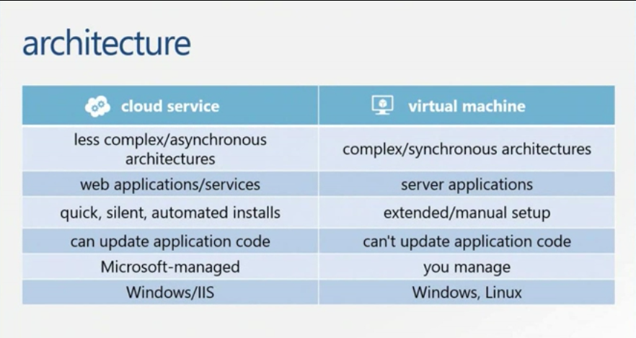
PaaS or IaaS?

Slide 19

Introducing Azure App Service
Unique integrated offering
Build intelligent web and mobile apps
Scale as your business grows
Azure Websites
Mobile Services
BizTalk Services
Key app services in Azure today

Slide 20

App Service
Web Apps
Mobile Apps
Web apps that scale with your business
Build Mobile apps for any device
LOGIC Apps
Api Apps
Automate business process across SaaS and on-premises
Easily build and consume APIs in the cloud

Slide 21
Full capability set available including:
.NET, Node.js, Java, PHP, and Python
WebJobs for long running tasks
Integrated VS publish, remote debug…
CI with GitHub, BitBucket, VSO
Auto-load balance, Autoscale, Geo DR
Virtual networking and hybrid connections
Site slots for staged deployments
Web Apps
Web apps run as-is
no changes required

Slide 22
New capabilities for Mobile apps:
WebJobs for long running tasks
CI with GitHub, BitBucket, VSO
Auto-load balance, Autoscale, Geo DR
Virtual networking and hybrid connections
Site slots for staged deployments
Mobile Apps
Mobile services plus
a whole lot more

Slide 23
New Logic Apps for easy automation
No code designer for rapid creation
Dozens of pre-built templates to get started
Out of box support for popular SaaS and on-premises apps
Use with custom API apps of your own
BizTalk APIs for expert integration scenarios
LOGIC Apps
Automate SaaS and
on-premises systems

Slide 24
Easily use cloud or custom APIs:
Dozens of built-in APIs for popular SaaS
An ecosystem of APIs for any need
Create and publish custom, reusable APIs
Visual Studio tooling with one click publish and remote debugging
Automatic client SDK generation for many languages
Api Apps
Create, consume and
host APIs more easily

Slide 25
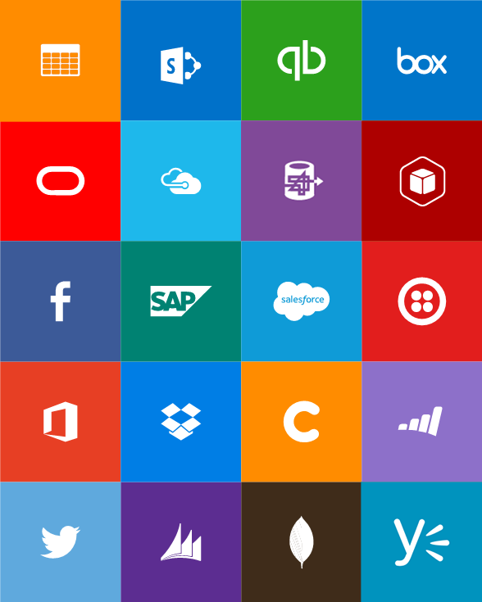
Built-in API Connectors
Connectors
Box
Chatter
Delay
Dropbox
Azure HD Insight
Marketo
Azure Media Services
OneDrive
SharePoint
SQL Server
Office 365
Oracle
QuickBooks
SalesForce
Sugar CRM
SAP
Azure Service Bus
Azure Storage
Timer / Recurrence
Twilio
Twitter
IBM DB2
Informix
Websphere MQ
Azure Web Jobs
Yammer
Dynamics CRM
Dynamics AX
Hybrid Connectivity
Protocols
BizTalk Services
HTTP, HTTPS
File
Flat File
FTP, SFTP
POP3/IMAP
SMTP
SOAP + WCF
Batching / Debatching
Validate
Extract (XPath)
Transform (+Mapper)
Convert (XML-JSON)
Convert (XML-FF)
X12
EDIFACT
AS2
TPMOM
Rules Engine

Slide 26
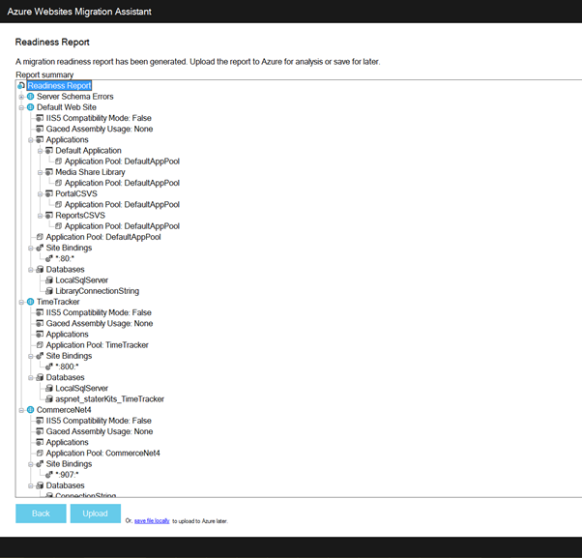
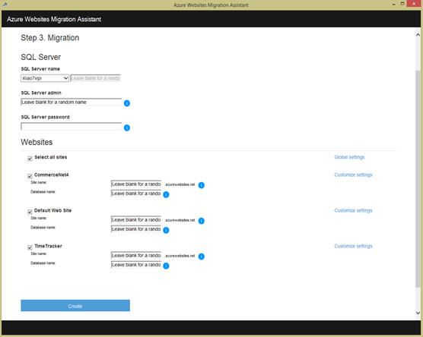
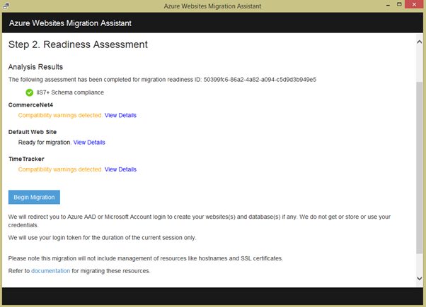
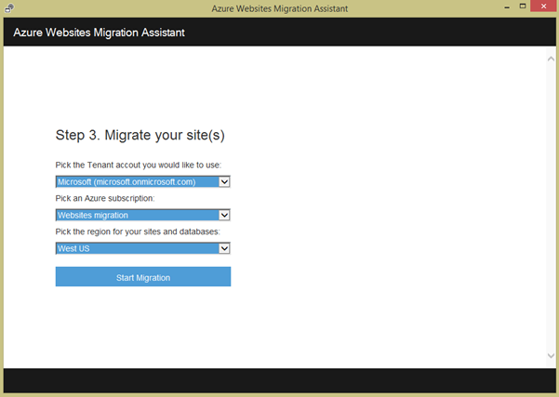
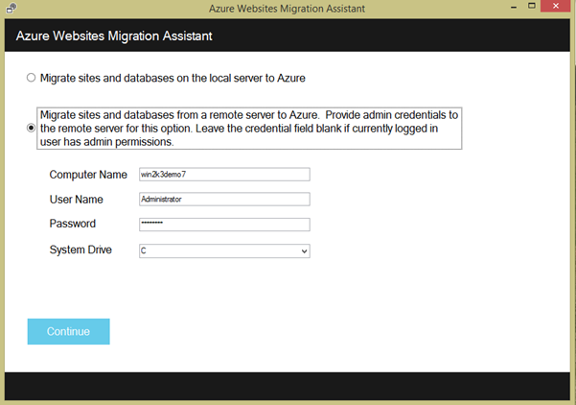
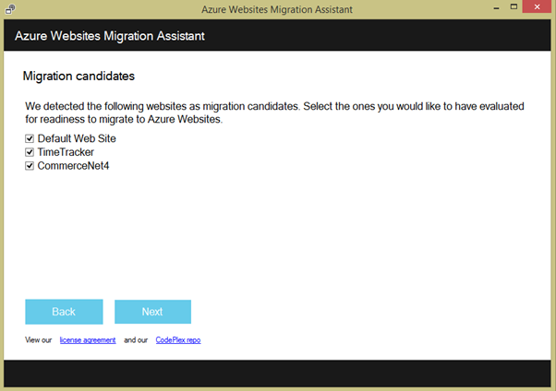
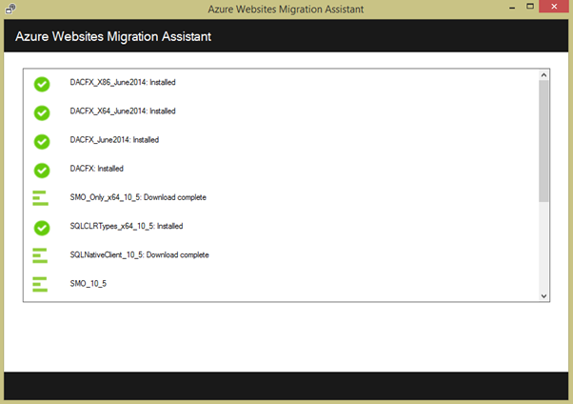
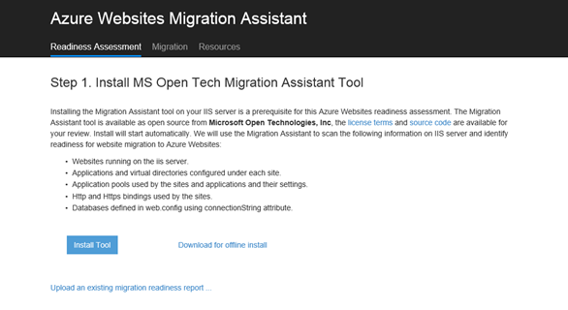
Walkthrough
https://www.youtube.com/watch?v=ZchrbiNa5Jw

Slide 27
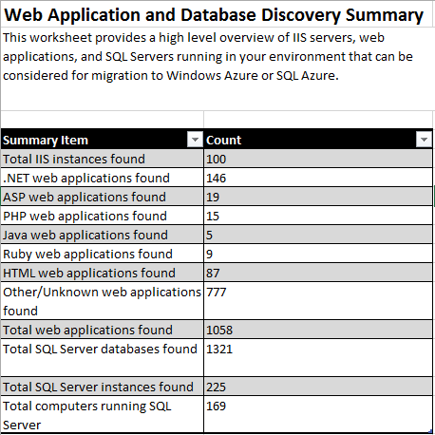
Application Analysis
MAP Toolkit
Accelerate your migration to the Windows Azure Platform
The Microsoft Assessment and Planning (MAP) Toolkit gets your cloud migration planning process going with automated discovery and detailed inventory reporting of web applications, application portfolios, and database readiness for the Windows Azure platform.
Catalog all of the applications in your environment: Inventory and report on web application portfolios and SQL Server database instances in your environment.

Slide 28
Migrate CloudShop App to Azure–
Virtual Machine…
Cloud Services
Azure Service Fabric
Web Sites
Web Site Migration Assistant
Map Tool Kit

Slide 29
The Future of PaaS

Slide 30
Database Migration
We shall be talking on this in next session….

Slide 31
Q & A

Slide 32
Contact Us Technical services to help you win more deals, accelerate deployment and increase consumption
Microsoft Azure
http://aka.ms/PartnerTechnicalServicesAzure
Microsoft CRM Online
http://aka.ms/PartnerTechnicalServicesCRMOnline
Microsoft Office 365
http://aka.ms/PartnerTechnicalServicesO365
Microsoft Windows 10 and Enterprise Mobility Suite
http://aka.ms/PartnerTechnicalServicesWin10EMS
Learn more about your technical support benefits
http://aka.ms/MySupport

Slide 33
Thank You! Gracias! Obrigado!

